Slide 1
The Metric Tensor

Slide 2


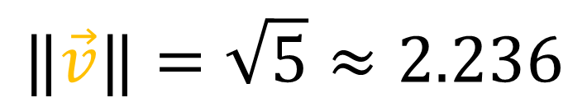
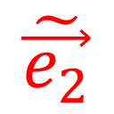
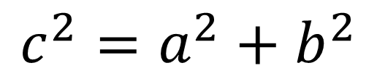
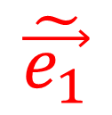
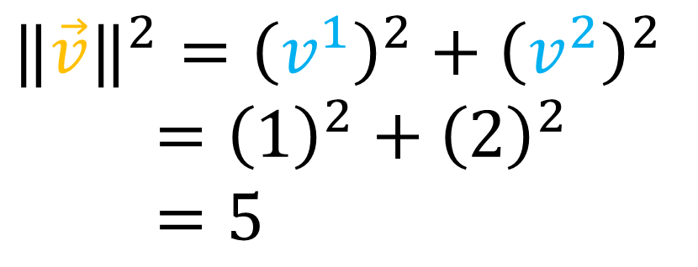

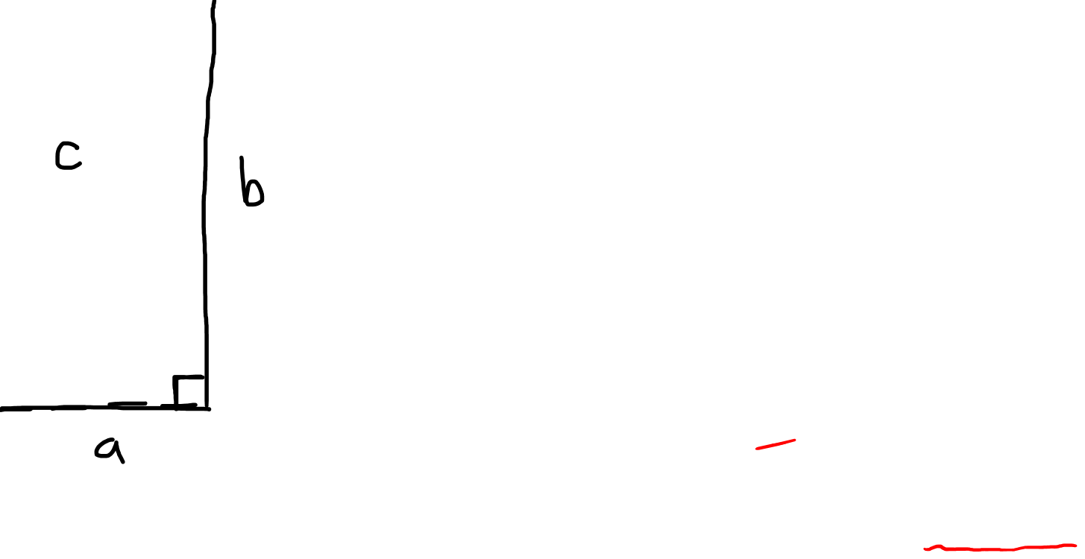
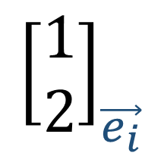

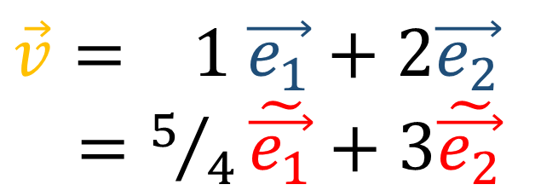
How do you get the length of a vector?
$$\vec{v}= 1 \vec{e_{1}}+2\vec{e_{2}}$$
$=5/4\tilde{\vec{e_{1}}}+3\tilde{\vec{e_{2}}}$
$${\left[\begin{aligned}\text{1} \\ 2\end{aligned}\right]}_{\vec{e_{i}}}$$
$$\vec{v}$$
$$\vec{e_{2}}$$
$$\tilde{\vec{e_{1}}}$$
$$c^{2}=a^{2}+b^{2}$$
$${‖\vec{v}‖}^{2}={\left(v^{1}\right)}^{2}+{\left(v^{2}\right)}^{2}$$
$={\left(1\right)}^{2}+{\left(2\right)}^{2}$
$=5$
$$\tilde{\vec{e_{2}}}$$
$$\vec{e_{1}}$$
$$‖\vec{v}‖=\sqrt{5}≈2.236$$

Slide 3

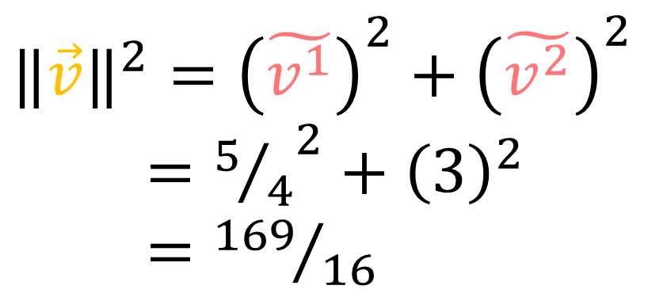
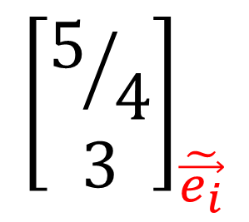
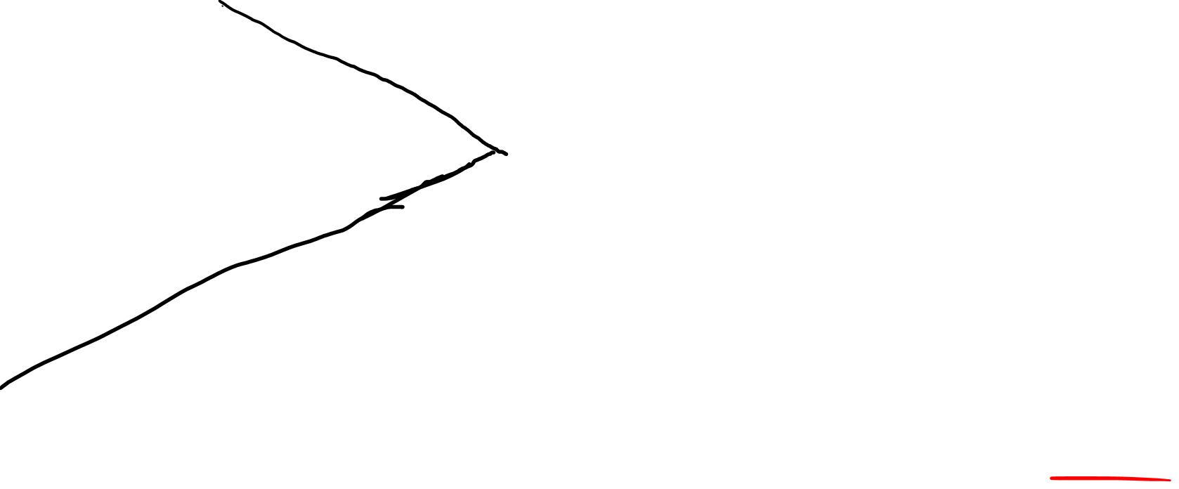
How do you get the length of a vector?
$$\vec{v}= 1 \vec{e_{1}}+2\vec{e_{2}}$$
$=5/4\tilde{\vec{e_{1}}}+3\tilde{\vec{e_{2}}}$
$${\left[\begin{aligned}5/4 \\ 3\end{aligned}\right]}_{\tilde{\vec{e_{i}}}}$$
$$\vec{v}$$
$$\vec{e_{2}}$$
$$\tilde{\vec{e_{1}}}$$
$${‖\vec{v}‖}^{2}={\left(\tilde{v^{1}}\right)}^{2}+{\left(\tilde{v^{2}}\right)}^{2}$$
$={5/4}^{2}+{\left(3\right)}^{2}$
$={169}/{16}$
$$\tilde{\vec{e_{2}}}$$
$$\vec{e_{1}}$$
$‖\vec{v}‖=\sqrt{{169}/{16}}=\frac{13}{4}=3.25?$

Slide 4
Pythagoras’s Theorem is a lie!*
*for non-orthonormal bases

Slide 5

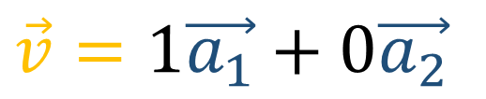







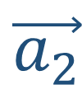
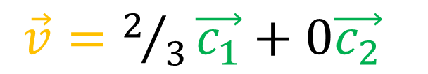



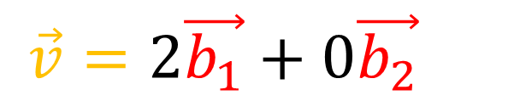
$$\vec{c_{1}}$$
$$\vec{a_{1}}$$
$$\vec{v}$$
$$\vec{b_{1}}$$
$$\vec{v}$$
$$\vec{v}$$
$$\vec{b_{2}}$$
$$\vec{c_{2}}$$
$$\vec{a_{2}}$$
$$\vec{v}=1\vec{a_{1}}+0\vec{a_{2}}$$
$\vec{v}=2\vec{b_{1}}+0\vec{b_{2}}$
$\vec{v}=2/3\vec{c_{1}}+0\vec{c_{2}}$
$${‖\vec{v}‖}^{2}={\left(1\right)}^{2}=1?$$
${‖\vec{v}‖}^{2}={\left(2\right)}^{2}=4?$
${‖\vec{v}‖}^{2}={\left(2/3\right)}^{2}=4/9?$

Slide 6

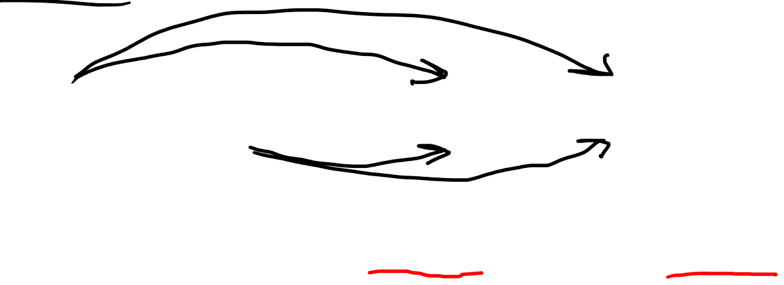
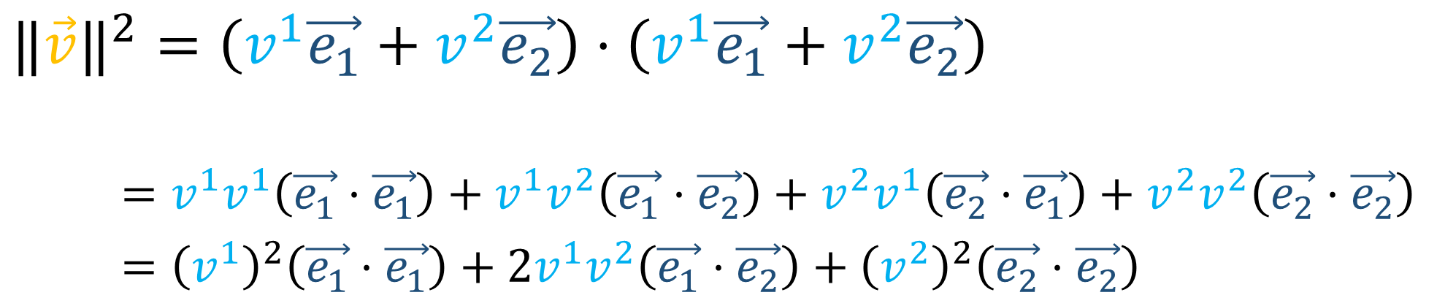
How do you get the length of a vector?
$${‖\vec{v}‖}^{2}=\vec{v}⋅\vec{v}$$
$${‖\vec{v}‖}^{2}=\left(v^{1}\vec{e_{1}}+v^{2}\vec{e_{2}}\right)⋅\left(v^{1}\vec{e_{1}}+v^{2}\vec{e_{2}}\right)$$
$=v^{1}v^{1}\left(\vec{e_{1}}⋅\vec{e_{1}}\right)+v^{1}v^{2}\left(\vec{e_{1}}⋅\vec{e_{2}}\right)+v^{2}v^{1}\left(\vec{e_{2}}⋅\vec{e_{1}}\right)+v^{2}v^{2}\left(\vec{e_{2}}⋅\vec{e_{2}}\right)$
$={\left(v^{1}\right)}^{2}\left(\vec{e_{1}}⋅\vec{e_{1}}\right)+2v^{1}v^{2}\left(\vec{e_{1}}⋅\vec{e_{2}}\right)+{\left(v^{2}\right)}^{2}\left(\vec{e_{2}}⋅\vec{e_{2}}\right)$
$$={\left(\tilde{v^{1}}\right)}^{2}\left(\tilde{\vec{e_{1}}}⋅\tilde{\vec{e_{1}}}\right)+2\tilde{v^{1}}\tilde{v^{2}}\left(\tilde{\vec{e_{1}}}⋅\tilde{\vec{e_{2}}}\right)+{\left(\tilde{v^{2}}\right)}^{2}\left(\tilde{\vec{e_{2}}}⋅\tilde{\vec{e_{2}}}\right)$$

Slide 7


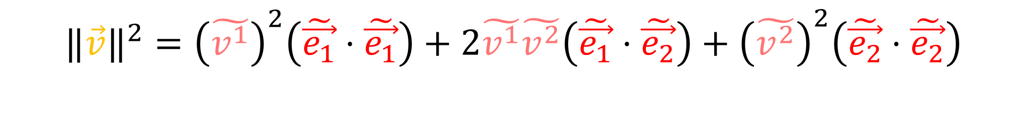

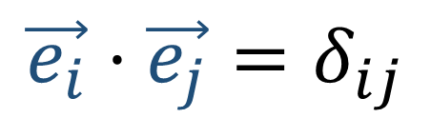

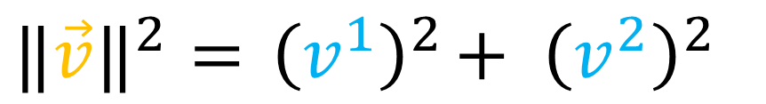

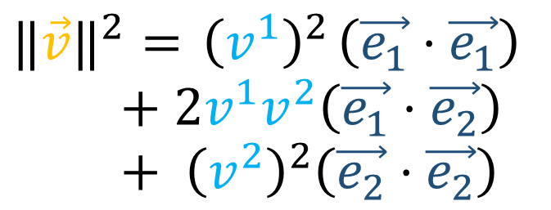
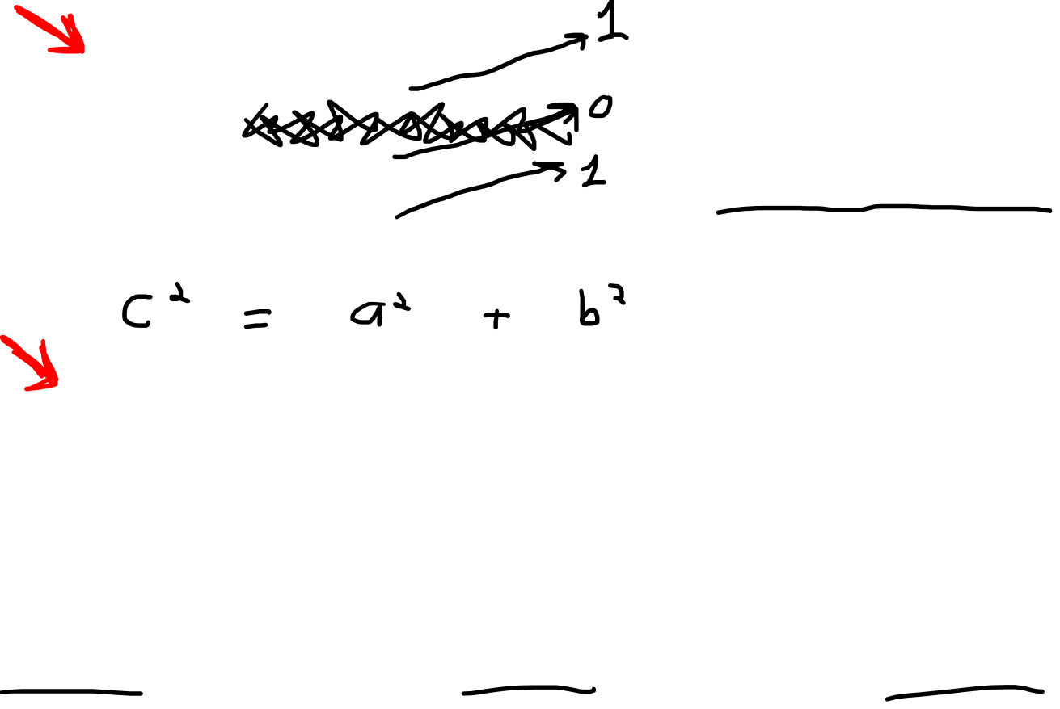
$${‖\vec{v}‖}^{2}={ \left(v^{1}\right)}^{2}\left(\vec{e_{1}}⋅\vec{e_{1}}\right)$$
$$+ 2v^{1}v^{2}\left(\vec{e_{1}}⋅\vec{e_{2}}\right)$$
$$+ {\left(v^{2}\right)}^{2}\left(\vec{e_{2}}⋅\vec{e_{2}}\right)$$
Orthonormal Basis
$$\vec{v}$$
$$\vec{e_{i}}⋅\vec{e_{j}}=δ_{ij}$$
$$\vec{e_{2}}$$
$$\tilde{\vec{e_{1}}}$$
$$\tilde{\vec{e_{2}}}$$
$$\vec{e_{1}}$$
$${‖\vec{v}‖}^{2}={ \left(v^{1}\right)}^{2}+ {\left(v^{2}\right)}^{2}$$
$${‖\vec{v}‖}^{2}={\left(\tilde{v^{1}}\right)}^{2}\left(\tilde{\vec{e_{1}}}⋅\tilde{\vec{e_{1}}}\right)+2\tilde{v^{1}}\tilde{v^{2}}\left(\tilde{\vec{e_{1}}}⋅\tilde{\vec{e_{2}}}\right)+{\left(\tilde{v^{2}}\right)}^{2}\left(\tilde{\vec{e_{2}}}⋅\tilde{\vec{e_{2}}}\right)$$

Slide 8
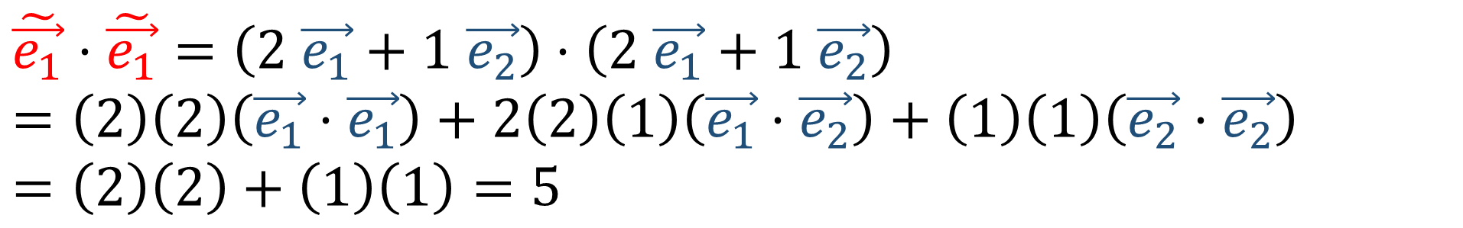
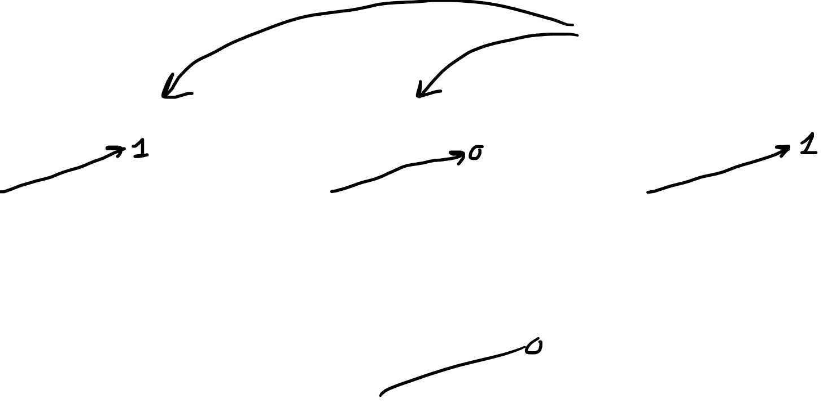
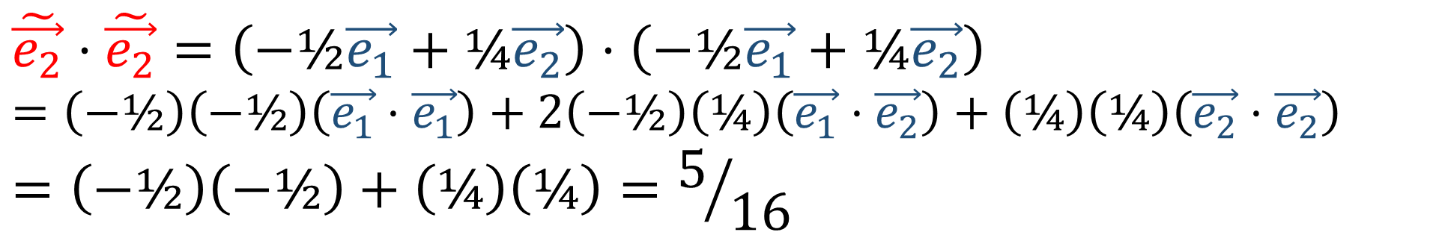
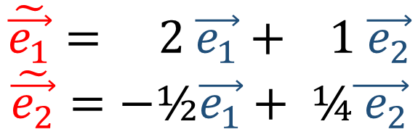
$$\tilde{\vec{e_{1}}}= 2 \vec{e_{1}}+ 1 \vec{e_{2}}$$
$$\tilde{\vec{e_{2}}}=−\text{½}\vec{e_{1}}+ \text{¼}\vec{{ e}_{2}}$$
$$\tilde{\vec{e_{1}}}⋅\tilde{\vec{e_{1}}}=\left(2 \vec{e_{1}}+1 \vec{e_{2}}\right)⋅\left(2 \vec{e_{1}}+1 \vec{e_{2}}\right)$$
$$=\left(2\right)\left(2\right)\left(\vec{e_{1}}⋅\vec{e_{1}}\right)+2\left(2\right)\left(1\right)\left(\vec{e_{1}}⋅\vec{e_{2}}\right)+\left(1\right)\left(1\right)\left(\vec{e_{2}}⋅\vec{e_{2}}\right)$$
$$=\left(2\right)\left(2\right)+\left(1\right)\left(1\right)=5$$
$$\tilde{\vec{e_{2}}}⋅\tilde{\vec{e_{2}}}=\left(−\text{½}\vec{e_{1}}+\text{¼}\vec{e_{2}}\right)⋅\left(−\text{½}\vec{e_{1}}+\text{¼}\vec{e_{2}}\right)$$
$$=\left(−\text{½}\right)\left(−\text{½}\right)\left(\vec{e_{1}}⋅\vec{e_{1}}\right)+2\left(−\text{½}\right)\left(\text{¼}\right)\left(\vec{e_{1}}⋅\vec{e_{2}}\right)+\left(\text{¼}\right)\left(\text{¼}\right)\left(\vec{e_{2}}⋅\vec{e_{2}}\right)$$
$$=\left(−\text{½}\right)\left(−\text{½}\right)+\left(\text{¼}\right)\left(\text{¼}\right)=5/{16}$$

Slide 9
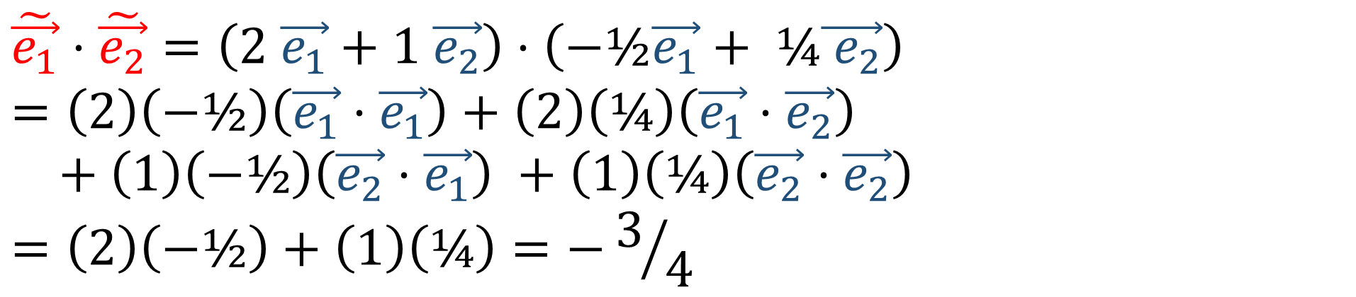

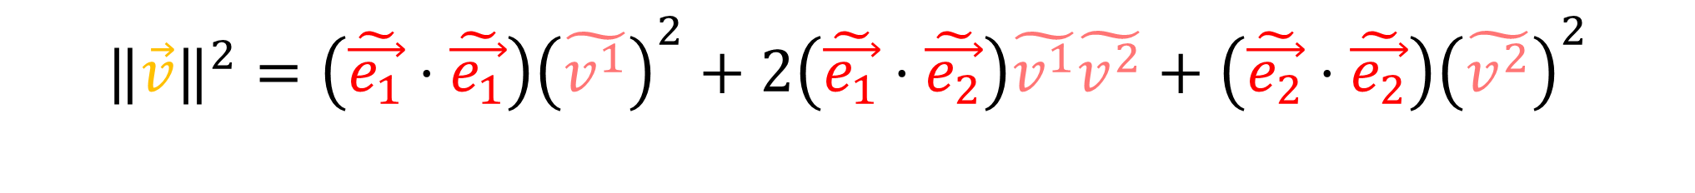

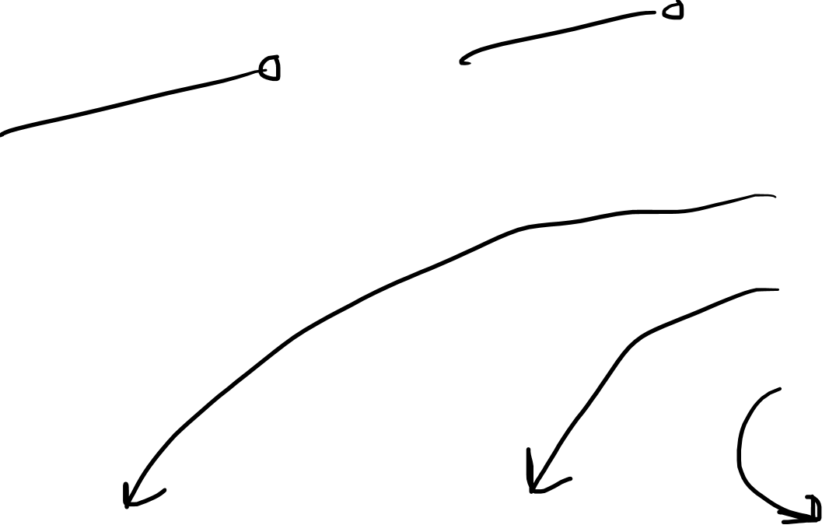
$$\tilde{\vec{e_{1}}}⋅\tilde{\vec{e_{2}}}=\left(2 \vec{e_{1}}+1 \vec{e_{2}}\right)⋅\left(−\text{½}\vec{e_{1}}+ \text{¼}\vec{{ e}_{2}}\right)$$
$$=\left(2\right)\left(−\text{½}\right)\left(\vec{e_{1}}⋅\vec{e_{1}}\right)+\left(2\right)\left(\text{¼}\right)\left(\vec{e_{1}}⋅\vec{e_{2}}\right)$$
$$+ \left(1\right)\left(−\text{½}\right)\left(\vec{e_{2}}⋅\vec{e_{1}}\right) +\left(1\right)\left(\text{¼}\right)\left(\vec{e_{2}}⋅\vec{e_{2}}\right)$$
$$=\left(2\right)\left(−\text{½}\right)+\left(1\right)\left(\text{¼}\right)=−3/4$$
$$\tilde{\vec{e_{1}}}= 2 \vec{e_{1}}+ 1 \vec{e_{2}}$$
$$\tilde{\vec{e_{2}}}=−\text{½}\vec{e_{1}}+ \text{¼}\vec{{ e}_{2}}$$
$$\tilde{\vec{e_{1}}}⋅\tilde{\vec{e_{1}}}=5$$
$$\tilde{\vec{e_{1}}}⋅\tilde{\vec{e_{2}}}=−3/4$$
$$\tilde{\vec{e_{2}}}⋅\tilde{\vec{e_{2}}}=5/{16}$$
$${‖\vec{v}‖}^{2}={\left(\tilde{\vec{e_{1}}}⋅\tilde{\vec{e_{1}}}\right)\left(\tilde{v^{1}}\right)}^{2}+2\left(\tilde{\vec{e_{1}}}⋅\tilde{\vec{e_{2}}}\right)\tilde{v^{1}}\tilde{v^{2}}+{\left(\tilde{\vec{e_{2}}}⋅\tilde{\vec{e_{2}}}\right)\left(\tilde{v^{2}}\right)}^{2}$$
$${‖\vec{v}‖}^{2}={5\left(\tilde{v^{1}}\right)}^{2}−6/4\tilde{v^{1}}\tilde{v^{2}}+{5/{16}\left(\tilde{v^{2}}\right)}^{2}$$

Slide 10

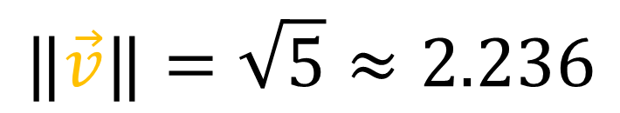

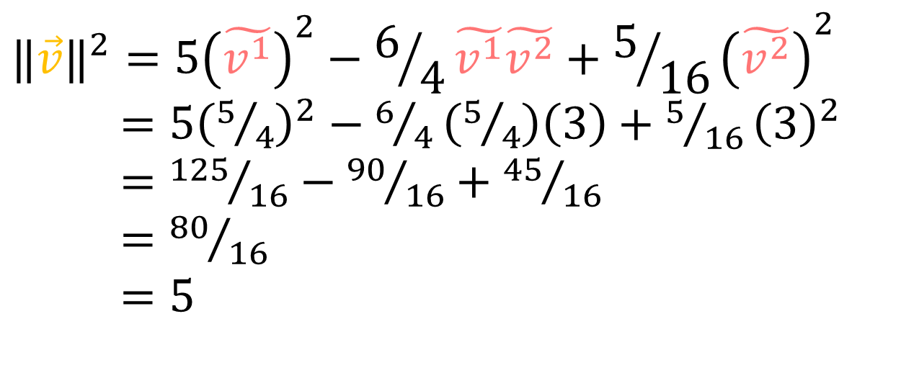
$${\left[\begin{aligned}5/4 \\ 3\end{aligned}\right]}_{\tilde{\vec{e_{i}}}}$$
$${‖\vec{v}‖}^{2}={5\left(\tilde{v^{1}}\right)}^{2}−6/4\tilde{v^{1}}\tilde{v^{2}}+{5/{16}\left(\tilde{v^{2}}\right)}^{2}$$
$={5\left(5/4\right)}^{2}−6/4\left(5/4\right)\left(3\right)+{5/{16}\left(3\right)}^{2}$
$={125}/{16}−{90}/{16}+{45}/{16}$
$={80}/{16}$
$=5$
$$\vec{v}$$
$$\vec{e_{2}}$$
$$\tilde{\vec{e_{1}}}$$
$$\tilde{\vec{e_{2}}}$$
$$\vec{e_{1}}$$
$$‖\vec{v}‖=\sqrt{5}≈2.236$$

Slide 11

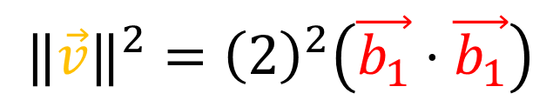

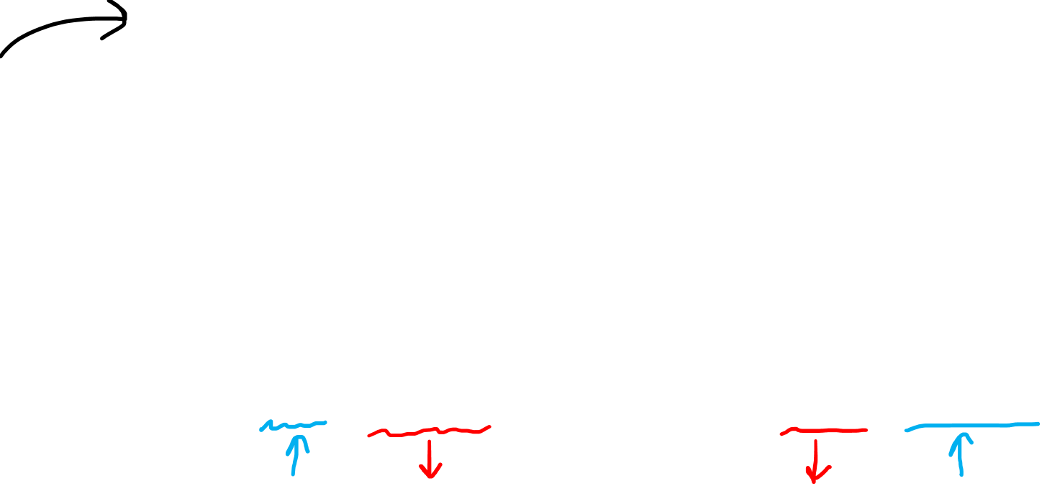
$$\vec{c_{1}}$$
$$\vec{a_{1}}$$
$$\vec{v}$$
$$\vec{b_{1}}$$
$$\vec{v}$$
$$\vec{v}$$
$$\vec{b_{2}}$$
$$\vec{c_{2}}$$
$$\vec{a_{2}}$$
$$\vec{v}=1\vec{a_{1}}+0\vec{a_{2}}$$
$\vec{v}=2\vec{b_{1}}+0\vec{b_{2}}$
$\vec{v}=2/3\vec{c_{1}}+0\vec{c_{2}}$
$${‖\vec{v}‖}^{2}={\left(1\right)}^{2}\left(\vec{a_{1}}⋅\vec{a_{1}}\right)$$
${‖\vec{v}‖}^{2}={\left(2\right)}^{2}\left(\vec{b_{1}}⋅\vec{b_{1}}\right)$
${‖\vec{v}‖}^{2}={\left(2/3\right)}^{2}\left(\vec{c_{1}}⋅\vec{c_{1}}\right)$

Slide 12

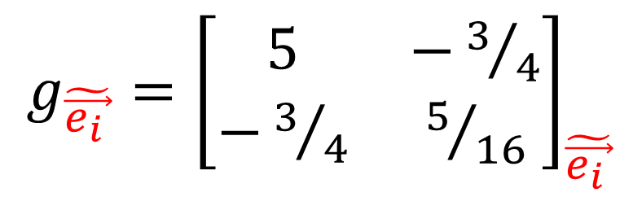
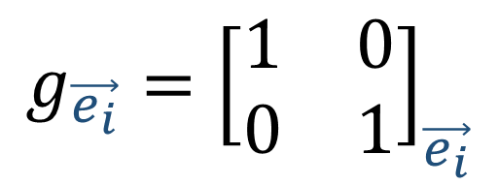
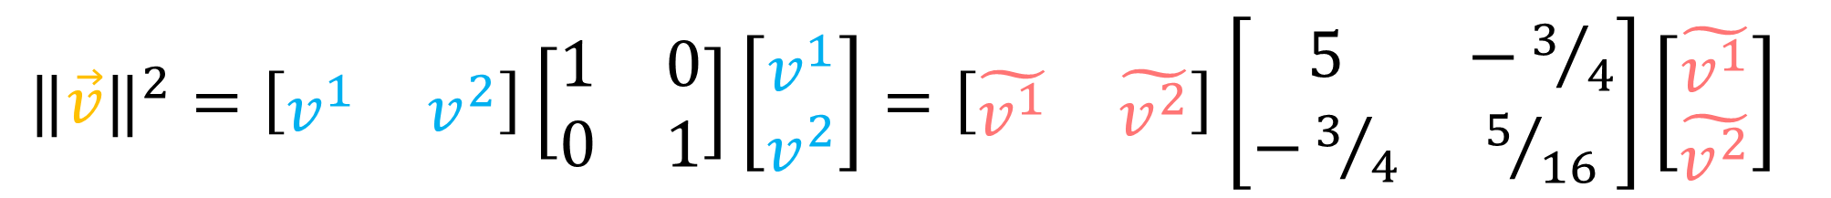
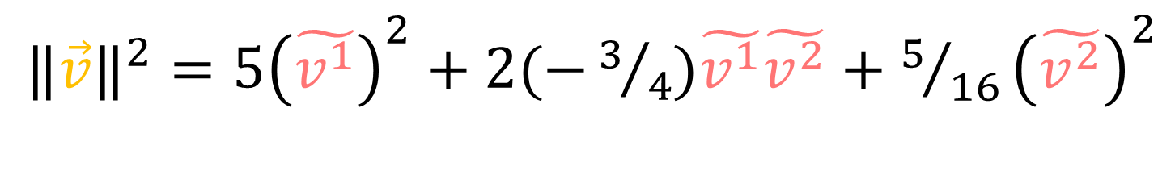
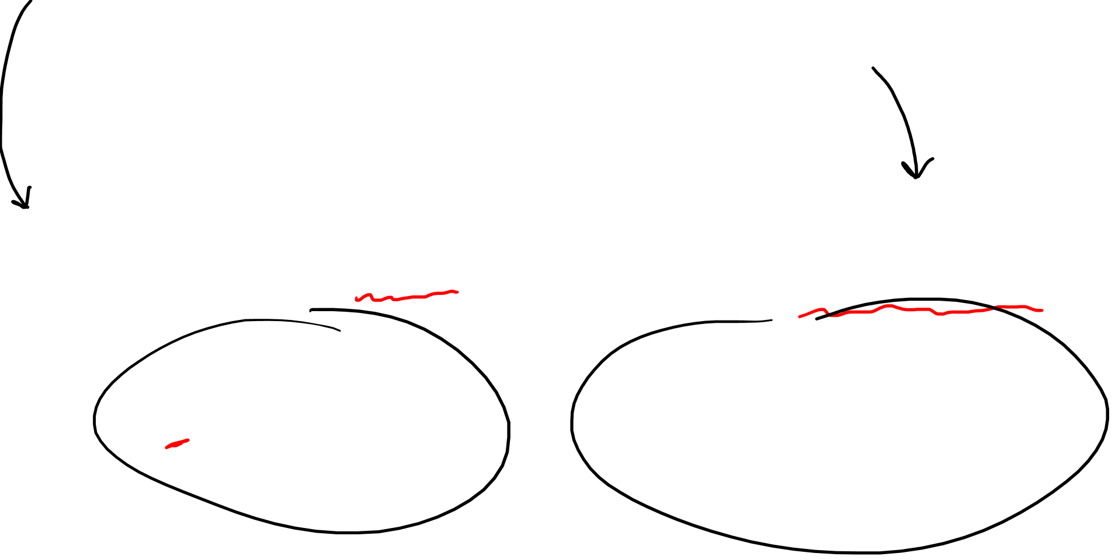
$${‖\vec{v}‖}^{2}={ \left(v^{1}\right)}^{2}+ {\left(v^{2}\right)}^{2}$$
${‖\vec{v}‖}^{2}={5\left(\tilde{v^{1}}\right)}^{2}+2(−3/4)\tilde{v^{1}}\tilde{v^{2}}+{5/{16}\left(\tilde{v^{2}}\right)}^{2}$
${‖\vec{v}‖}^{2}=\left[\begin{matrix}v^{1} & v^{2}\end{matrix}\right]\left[\begin{matrix}1 & 0 \\ 0 & 1\end{matrix}\right]\left[\begin{aligned}v^{1} \\ v^{2}\end{aligned}\right]=\left[\begin{matrix}\tilde{v^{1}} & \tilde{v^{2}}\end{matrix}\right]\left[\begin{matrix}5 & −3/4 \\ −3/4 & 5/{16}\end{matrix}\right]\left[\begin{aligned}\tilde{v^{1}} \\ \tilde{v^{2}}\end{aligned}\right]$
$g_{\tilde{\vec{e_{i }}}}={\left[\begin{matrix}5 & −3/4 \\ −3/4 & 5/{16}\end{matrix}\right]}_{\tilde{\vec{e_{i }}}}$
$${g_{\vec{e_{i}}}=\left[\begin{matrix}1 & 0 \\ 0 & 1\end{matrix}\right]}_{\vec{e_{i}}}$$

Slide 13


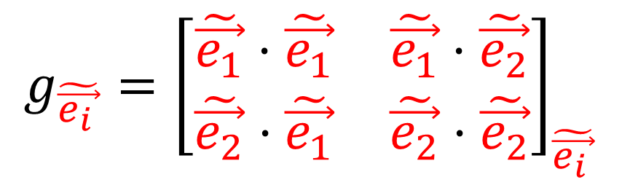
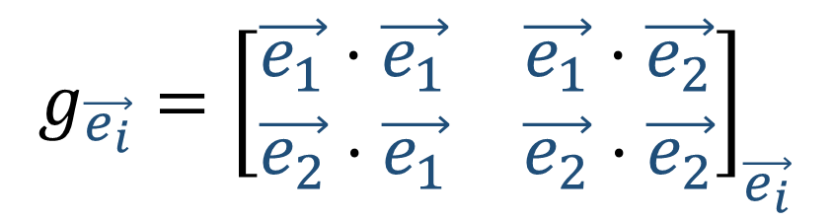

$${‖\vec{v}‖}^{2}={\left(v^{1}\right)}^{2}\left(\vec{e_{1}}⋅\vec{e_{1}}\right)+2v^{1}v^{2}\left(\vec{e_{1}}⋅\vec{e_{2}}\right)+{\left(v^{2}\right)}^{2}\left(\vec{e_{2}}⋅\vec{e_{2}}\right)$$
$${‖\vec{v}‖}^{2}={\left(\tilde{v^{1}}\right)}^{2}\left(\tilde{\vec{e_{1}}}⋅\tilde{\vec{e_{1}}}\right)+2\tilde{v^{1}}\tilde{v^{2}}\left(\tilde{\vec{e_{1}}}⋅\tilde{\vec{e_{2}}}\right)+{\left(\tilde{v^{2}}\right)}^{2}\left(\tilde{\vec{e_{2}}}⋅\tilde{\vec{e_{2}}}\right)$$
$${g_{\vec{e_{i}}}=\left[\begin{matrix}\vec{e_{1}}⋅\vec{e_{1}} & \vec{e_{1}}⋅\vec{e_{2}} \\ \vec{e_{2}}⋅\vec{e_{1}} & \vec{e_{2}}⋅\vec{e_{2}}\end{matrix}\right]}_{\vec{e_{i}}}$$
$g_{\tilde{\vec{e_{i }}}}={\left[\begin{matrix}\tilde{\vec{e_{1}}}⋅\tilde{\vec{e_{1}}} & \tilde{\vec{e_{1}}}⋅\tilde{\vec{e_{2}}} \\ \tilde{\vec{e_{2}}}⋅\tilde{\vec{e_{1}}} & \tilde{\vec{e_{2}}}⋅\tilde{\vec{e_{2}}}\end{matrix}\right]}_{\tilde{\vec{e_{i }}}}$
$${‖\vec{v}‖}^{2}=v^{i}v^{j}\left(\vec{e_{i}}⋅\vec{e_{j}}\right)=v^{i}v^{j}g_{ij}$$
$=\tilde{v^{i}}\tilde{v^{j}}\left(\tilde{\vec{e_{i}}}⋅\tilde{\vec{e_{j}}}\right)=\tilde{v^{i}}\tilde{v^{j}}\tilde{g_{ij}}$
$$g_{ij}=\left(\vec{e_{i}}⋅\vec{e_{j}}\right)$$
$$\tilde{g_{ij}}=\left(\tilde{\vec{e_{i}}}⋅\tilde{\vec{e_{j}}}\right)$$

Slide 14

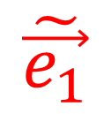

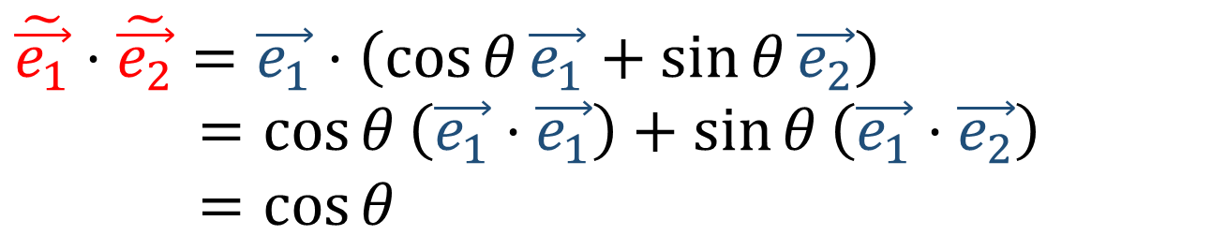

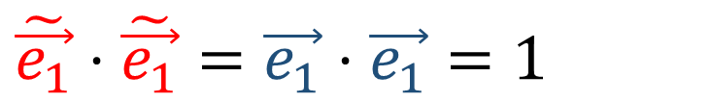




$$\vec{e_{2}}$$
$$\tilde{\vec{e_{1}}}=\vec{e_{1}}$$
$$\tilde{\vec{e_{2}}}=\left(\cos{θ}\right)\vec{e_{1}}+\left(\sin{θ}\right)\vec{e_{2}}$$
$$\tilde{\vec{e_{2}}}$$
$$\tilde{\vec{e_{1}}}⋅\tilde{\vec{e_{1}}}=\vec{e_{1}}⋅\vec{e_{1}}=1$$
$$θ$$
$$\vec{e_{1}}$$
$$\tilde{\vec{e_{1}}}⋅\tilde{\vec{e_{2}}}=\vec{e_{1}}⋅\left(\cos{θ}\vec{e_{1}}+\sin{θ}\vec{e_{2}}\right)$$
$=\cos{θ}\left(\vec{e_{1}}⋅\vec{e_{1}}\right)+\sin{θ}\left(\vec{e_{1}}⋅\vec{e_{2}}\right)$
$=\cos{θ}$
$$\tilde{\vec{e_{1}}}$$
$$\tilde{\vec{e_{2}}}⋅\tilde{\vec{e_{2}}}=\left(\cos{θ}\vec{e_{1}}+\sin{θ}\vec{e_{2}}\right)⋅\left(\cos{θ}\vec{e_{1}}+\sin{θ}\vec{e_{2}}\right)$$
$={\left(\cos{θ}\right)}^{2}\left(\vec{e_{1}}⋅\vec{e_{1}}\right)+{\left(\sin{θ}\right)}^{2}\left(\vec{e_{2}}⋅\vec{e_{2}}\right)+\left(2\cos{θ}\sin{θ}\right)\left(\vec{e_{1}}⋅\vec{e_{2}}\right)$
$={\left(\cos{θ}\right)}^{2}+{\left(\sin{θ}\right)}^{2}=1$

Slide 15




$$\vec{e_{2}}$$
$$\tilde{\vec{e_{1}}}=\vec{e_{1}}$$
$$\tilde{\vec{e_{2}}}=\left(\cos{θ}\right)\vec{e_{1}}+\left(\sin{θ}\right)\vec{e_{2}}$$
$$\tilde{\vec{e_{2}}}$$
$$\tilde{\vec{e_{1}}}⋅\tilde{\vec{e_{1}}}=1$$
$$\tilde{\vec{e_{1}}}⋅\tilde{\vec{e_{2}}}=\cos{θ}$$
$$\tilde{\vec{e_{2}}}⋅\tilde{\vec{e_{2}}}=1$$
$$θ$$
$$\vec{e_{1}}$$
$$\tilde{\vec{e_{1}}}$$
$${g_{\vec{e_{i}}}=\left[\begin{matrix}1 & 0 \\ 0 & 1\end{matrix}\right]}_{\vec{e_{i}}}$$
$g_{\tilde{\vec{e_{i }}}}={\left[\begin{matrix}1 & \cos{θ} \\ \cos{θ} & 1\end{matrix}\right]}_{\tilde{\vec{e_{i }}}}$

Slide 16









$$\vec{w}$$
$$(\vec{v}⋅\vec{w})=\left(a\tilde{\vec{e_{1}}}\right)⋅\left(b\tilde{\vec{e_{2}}}\right)$$
$$=ab\left(\tilde{\vec{e_{1}}}⋅\tilde{\vec{e_{2}}}\right)$$
$=ab\cos{θ}$
$=‖\vec{v}‖‖\vec{w}‖\cos{θ}$
$$\tilde{\vec{e_{2}}}$$
$$θ$$
$$\tilde{\vec{e_{1}}}$$
$$\vec{v}$$
$$\tilde{\vec{e_{1}}}⋅\tilde{\vec{e_{1}}}=1$$
$$\tilde{\vec{e_{1}}}⋅\tilde{\vec{e_{2}}}=\cos{θ}$$
$$\tilde{\vec{e_{2}}}⋅\tilde{\vec{e_{2}}}=1$$
$$\frac{(\vec{v}⋅\vec{w})}{‖\vec{v}‖‖\vec{w}‖}=\cos{θ}$$

Slide 17




$$\left(\vec{v}⋅\vec{w}\right)=\left(v^{1}\vec{e_{1}}+v^{2}\vec{e_{2}}\right)⋅\left(w^{1}\vec{e_{1}}+w^{2}\vec{e_{2}}\right)$$
$=v^{1}w^{1}\left(\vec{e_{1}}⋅\vec{e_{1}}\right)+v^{2}w^{2}\left(\vec{e_{2}}⋅\vec{e_{2}}\right)$ $+v^{1}w^{2}\left(\vec{e_{1}}⋅\vec{e_{2}}\right)+v^{2}w^{1}\left(\vec{e_{2}}⋅\vec{e_{1}}\right)$
$=v^{1}w^{1}g_{11}+v^{2}w^{2}g_{22}$ $+v^{1}w^{2}g_{12}$ $+v^{2}w^{1}g_{21}$
$=v^{i}w^{j}g_{ij}$
$$\vec{v}⋅\vec{v}={‖\vec{v}‖}^{2}=v^{i}v^{j}g_{ij}$$
$$\vec{w}⋅\vec{w}={‖\vec{w}‖}^{2}=w^{i}w^{j}g_{ij}$$
$$\vec{v}⋅\vec{w}=‖\vec{v}‖‖\vec{w}‖\cos{θ}=v^{i}w^{j}g_{ij}$$
$$\frac{(\vec{v}⋅\vec{w})}{‖\vec{v}‖‖\vec{w}‖}=\cos{θ}$$

Slide 18






$$\tilde{g_{ij}}=\tilde{\vec{e_{i}}}⋅\tilde{\vec{e_{j}}}$$
$=\left(F_{i}^{k}\vec{e_{k}}\right)⋅\left(F_{j}^{l}\vec{e_{l}}\right)$
$$=F_{i}^{k}F_{j}^{l}\left(\vec{e_{k}}⋅\vec{e_{l}}\right)$$
$=F_{i}^{k}F_{j}^{l}g_{kl}$
$$\tilde{\vec{e_{j}}}=F_{j}^{i}\vec{e_{i}}$$
$$\vec{e_{j}}=B_{j}^{i}\tilde{\vec{e_{i}}}$$
$$\tilde{g_{ij}}=F_{i}^{k}F_{j}^{l}g_{kl}$$
$$g_{kl}=B_{k}^{i}B_{l}^{j}\tilde{g_{ij}}$$

Slide 19





$${‖\vec{v}‖}^{2}=\tilde{v^{i}}\tilde{v^{j}}\tilde{g_{ij}}$$
$=\left(B_{a}^{i}v^{a}\right)\left(B_{b}^{j}v^{b}\right)\left(F_{i}^{k}F_{j}^{l}g_{kl}\right)$
$=v^{a}v^{b}g_{kl}\left(B_{a}^{i}F_{i}^{k}B_{b}^{j}F_{j}^{l}\right)$
$=v^{a}v^{b}g_{kl}\left(δ_{a}^{k}δ_{b}^{l}\right)$
$=v^{k}v^{l}g_{kl}$
$$\tilde{v^{i}}=B_{j}^{i}v^{j}$$
$$v^{i}=F_{j}^{i}\tilde{v^{j}}$$
$$\tilde{g_{ij}}=F_{i}^{k}F_{j}^{l}g_{kl}$$
$$g_{kl}=B_{k}^{i}B_{l}^{j}\tilde{g_{ij}}$$

Slide 20












Contravariant (1,0)-Tensor
(1,1)-Tensor
$$\tilde{ε^{i}} =B_{j}^{i}ε^{j}$$
$$\tilde{v^{i}}=B_{j}^{i}v^{j}$$
$$\tilde{L_{j}^{i}}=B_{k}^{i}L_{l}^{k}F_{j}^{l}$$
$$ε^{i}=F_{j}^{i}\tilde{ε^{j}}$$
$$v^{i}=F_{j}^{i}\tilde{v^{j}}$$
$$L_{j}^{i}=F_{k}^{i}\tilde{L_{l}^{k}}B_{j}^{l}$$
Covariant (0,1)-Tensor
(0,2)-Tensor
$$\tilde{\vec{e_{j}}}=F_{j}^{i}\vec{e_{i}}$$
$$\tilde{α_{j}}=F_{j}^{i}α_{i}$$
$$\tilde{g_{ij}}=F_{i}^{k}F_{j}^{l}g_{kl}$$
$$g_{kl}=B_{k}^{i}B_{l}^{j}\tilde{g_{ij}}$$
$$\vec{e_{j}}=B_{j}^{i}\tilde{\vec{e_{i}}}$$
$$α_{j}=B_{j}^{i}\tilde{α_{i}}$$

Slide 21



2. Tensor = an object that is invariant under a change of coordinates, and…
has components that change in a special, predictable way under a change of coordinates
$$\tilde{T_{xyz…}^{abc…}}=\left(B_{i}^{a}B_{j}^{b}B_{k}^{c}⋯\right)T_{rst…}^{ijk…}\left(F_{x}^{r}F_{y}^{s}F_{z}^{t}⋯\right)$$
$$T_{rst…}^{ijk…}=\left(F_{a}^{i}F_{b}^{j}F_{c}^{k}⋯\right)\tilde{T_{xyz…}^{abc…}}\left(B_{r}^{x}B_{s}^{y}B_{t}^{z}⋯\right)$$

Slide 22


2. Tensor = an object that is invariant under a change of coordinates, and…
has components that change in a special, predictable way under a change of coordinates
m = # contravariant indexes
$$T_{rst…}^{ijk…}$$
n = # covariant indexes
(m,n)-Tensor

Slide 23

3. Tensor = a collection of vectors and covectors combined together using the tensor product
Notes:
More advanced… You’ve possibly never heard of a covector. Possibly never heard of the tensor product before. But this definition is really nice because we only really need to understand 3 things. We know almost all the basics

